Slide 1
Building iOS Swift apps
5030-201720_MCS5993_M: 5030-Topics in Computer Science
5031-201720_MCS4993_M: 5031-Topics in MA/CS

Slide 2
Agenda
Performance Tuning
Notes:
git clone https://github.com/aminbenarieb/Instruments-Tutorial

Slide 3
Instruments
Notes:
Know When to Use Instruments
While testing your app with Xcode, consult the debug navigator gauges (Figure 2-2) before diving into Instruments. These gauges provide high-level information about your app’s CPU, memory, energy usage, and more. Often, they provide all the information you need to improve performance and resolve common problems quickly. Use Instruments when you need to perform more detailed analysis.

Slide 4
Flickr Search app
https://www.raywenderlich.com/97886/instruments-tutorial-with-swift-getting-started
git clone https://github.com/aminbenarieb/Instruments-Tutorial
https://www.flickr.com/services/api/explore/flickr.photos.search
Add new API Key to FlickrSearcher.swift
Perform a search
Notes:
git clone https://github.com/aminbenarieb/Instruments-Tutorial

Slide 5
Agenda
Notes:
At a high level, it consists of the following main phases:
Set up a trace document containing the desired instruments and settings.
Target a device and an app to profile.
Profile the app.
Analyze the data captured during profiling.
Fix any problems in your source code.

Slide 6
Instruments
Set up a trace document containing the desired instruments and settings.
Target a device and an app to profile.
Profile the app.
Analyze the data captured during profiling.
Fix any problems in your source code.

Slide 7
Time Profiler
Notes:
The first instrument you’ll look at is the Time Profiler. At measured intervals, Instruments will halt the execution of the program and take a stack trace on each running thread. Think of it as pressing the pause button in Xcode’s debugger.
This screen displays the Call Tree. The Call Tree shows the amount of time spent executing in various methods within an app. Each row is a different method that the program’s execution path has followed. The time spent in each method can be determined from the number of times the profiler is stopped in each method.
For instance, if 100 samples are done at 1 millisecond intervals, and a particular method is found to be at the top of the stack in 10 samples, then you can deduce that approximately 10% of the total execution time — 10 milliseconds — was spent in that method. It’s a fairly crude approximation, but it works!

Slide 8
Profile
Notes:
Press Command-I.
Xcode builds your project, Instruments launches, and you’re prompted to select a profiling template.

Slide 9
Notes:
Choose Time Profiler

Slide 10
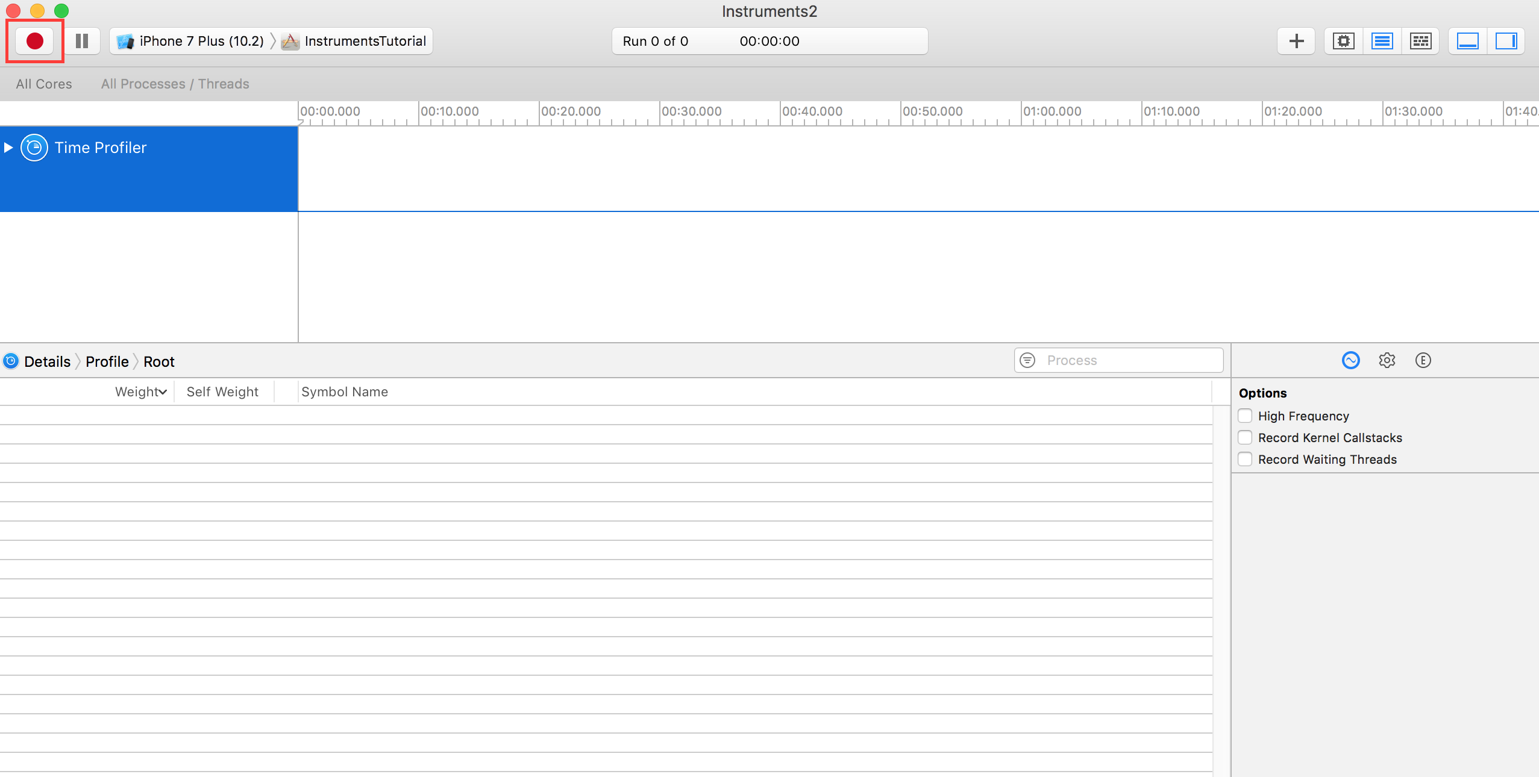
Notes:
Click the red record button in the top left to start recording and launch the app. In the Instruments window, you can see the time counting up, and a little arrow moving from left to right above the graph in the center of the screen. This indicates that the app is running.

Slide 11

Notes:
Now, start using the app. Search for some images, and drill down into one or more of the search results. You have probably noticed that going into a search result is tediously slow, and scrolling through a list of search results is also incredibly annoying – it’s a terribly clunky app!

Slide 12
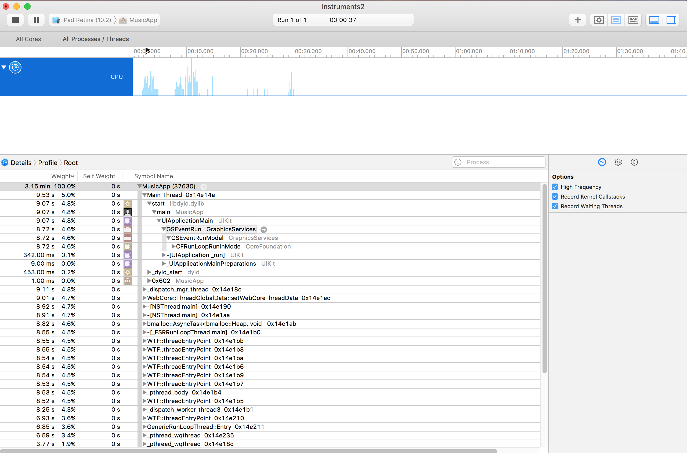
Notes:
Choose Time Profiler and start using the app.

Slide 13
Notes:
These are the recording controls. The red ‘record’ button will stop & start the app currently being profiled when it is clicked (it toggles between a record and stop icon). The pause button does exactly what you’d expect and pauses the current execution of the app.
This is the run timer. The timer counts how long the app being profiled has been running, and how many times it has been run. If you stop and then restart the app using the recording controls, that would start a new run and the display would then show Run 2 of 2.
This is called a track. In the case of the Time Profiler template you selected, there’s just one instrument so there’s just one track. You’ll learn more about the specifics of the graph shown here later in the tutorial.

Slide 14
Notes:
4. This is the detail panel. It shows the main information about the particular instrument you’re using. In this case, it’s showing the methods which are “hottest” — that is, the ones that have used up the most CPU time.If you click on the bar at the top which says Call Tree (the left hand one) and select Sample List, then you are presented with a different view of the data. This view is showing every single sample. Click on a few samples, and you’ll see the captured stack trace appear in the Extended Detail inspector.
5. This is the inspectors panel. There are three inspectors: Record Settings, Display Settings, and Extended Detail. You’ll be learning more about some of these options shortly.

Slide 15

Notes:
Perform an image search, and drill into the results. I personally like searching for “dog”, but choose whatever you wish – you might be one of those cat people! :]
Now, scroll up and down the list a few times so that you’ve got a good amount of data in the Time Profiler. You should notice the numbers in the middle of the screen changing and the graph filling in; this tells you that CPU cycles are being used.
You really wouldn’t expect any UI to be as clunky as this; no table view is ready to ship until it scrolls like butter! To help pinpoint the problem, you need to set some options.

Slide 16
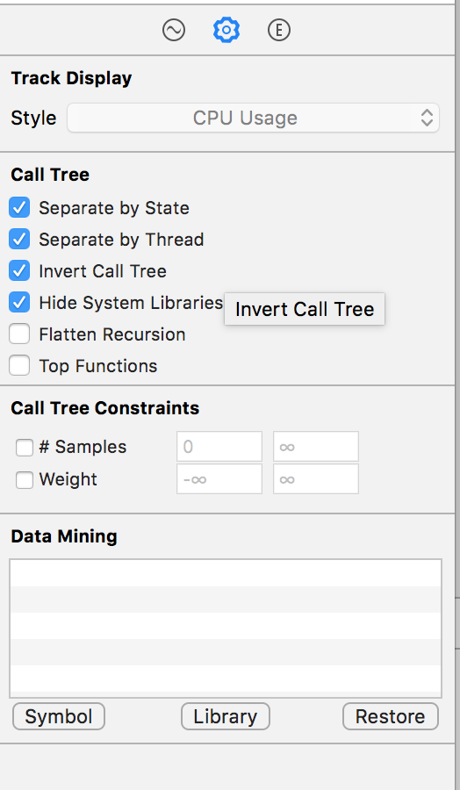
Notes:
On the right hand side, select the Display Settings inspector (or press ⌘+2). In the inspector, under the Call Tree section, select Separate by Thread, Invert Call Tree, Hide Missing Symbols and Hide System Libraries. It will look like this:

Slide 17
Notes:
Separate by Thread: Each thread should be considered separately. This enables you to understand which threads are responsible for the greatest amount of CPU use.
Invert Call Tree: With this option, the stack trace is considered from top to bottom. This is usually what you want, as you want to see the deepest methods where the CPU is spending its time.
Hide Missing Symbols: If the dSYM file cannot be found for your app or a system framework, then instead of seeing method names (symbols) in the table, you’ll just see hex values corresponding to addresses inside the binary. If this option is selected, then only fully resolved symbols are displayed and the unresolved hex values are hidden. This helps to declutter the data presented.
Hide System Libraries: When this option is selected, only symbols from your own app are displayed. It’s often useful to select this option, since usually you only care about where the CPU is spending time in your own code – you can’t do much about how much CPU the system libraries are using!
Flatten Recursion: This option treats recursive functions (ones which call themselves) as one entry in each stack trace, rather than multiple.
Top Functions: Enabling this makes Instruments consider the total time spent in a function as the sum of the time directly within that function, as well as the time spent in functions called by that function. So if function A calls B, then A’s time is reported as the time spent in A PLUS the time spent in B. This can be really useful, as it lets you pick the largest time figure each time you descend into the call stack, zeroing in on your most time-consuming methods.

Slide 18
Notes:
Run the app again
Well, that certainly doesn’t look too good. The vast majority of time is spent in the method that applies the ‘tonal’ filter to the thumbnail photos. That shouldn’t come as too much of a shock to you, as the table loading and scrolling were the clunkiest parts of the UI, and that’s when the table cells are constantly being updated.

Slide 19
Notes:
Run the app again
Well, that certainly doesn’t look too good. The vast majority of time is spent in the method that applies the ‘tonal’ filter to the thumbnail photos. That shouldn’t come as too much of a shock to you, as the table loading and scrolling were the clunkiest parts of the UI, and that’s when the table cells are constantly being updated.

Slide 20
Notes:
Now you can see what the problem is. The method to apply the tonal filter takes a long time to execute, and it’s called directly from cellForItemAtIndexPath, which will block the main thread (and therefore the entire UI) each time it’s ask for a filtered image.

Slide 21
Notes:
You could now switch to Xcode and manually find the source file you’re looking at in Instruments, but there’s a handy Open in Xcode button right in front of your eyes. Locate it in the panel just above the code and click it:

Slide 22
Allocations
Notes:
The next instrument covered in this tutorial is the Allocations instrument. This gives you detailed information about all the objects that are being created and the memory that backs them; it also shows you retain counts of each object.
To start afresh with a new instruments profile, quit the Instruments app. This time, build and run the app, and open the Debug Navigator in the Navigators area. Then click on Memory to display graphs of memory usage in the main window:

Slide 23
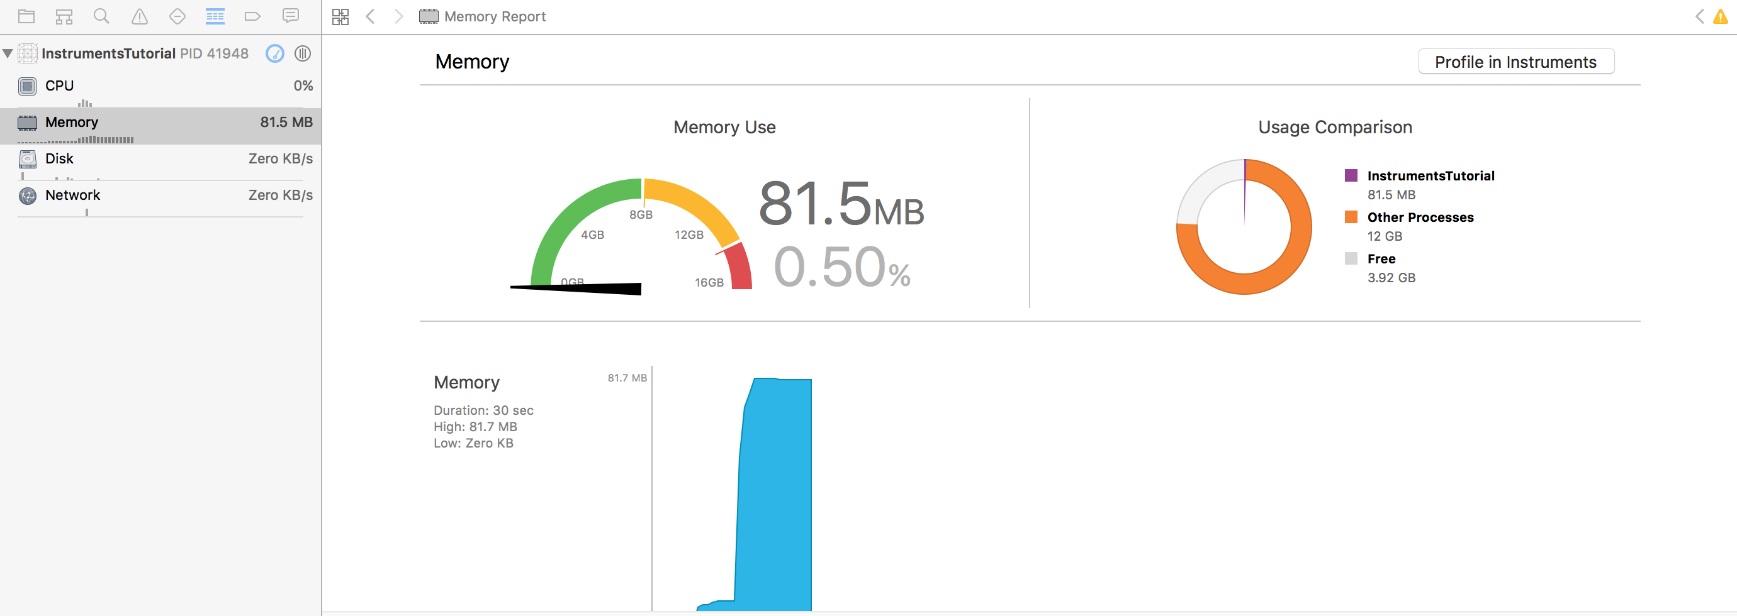
Notes:
The next instrument covered in this tutorial is the Allocations instrument. This gives you detailed information about all the objects that are being created and the memory that backs them; it also shows you retain counts of each object.
To start afresh with a new instruments profile, quit the Instruments app. This time, build and run the app, and open the Debug Navigator in the Navigators area. Then click on Memory to display graphs of memory usage in the main window:

Slide 24
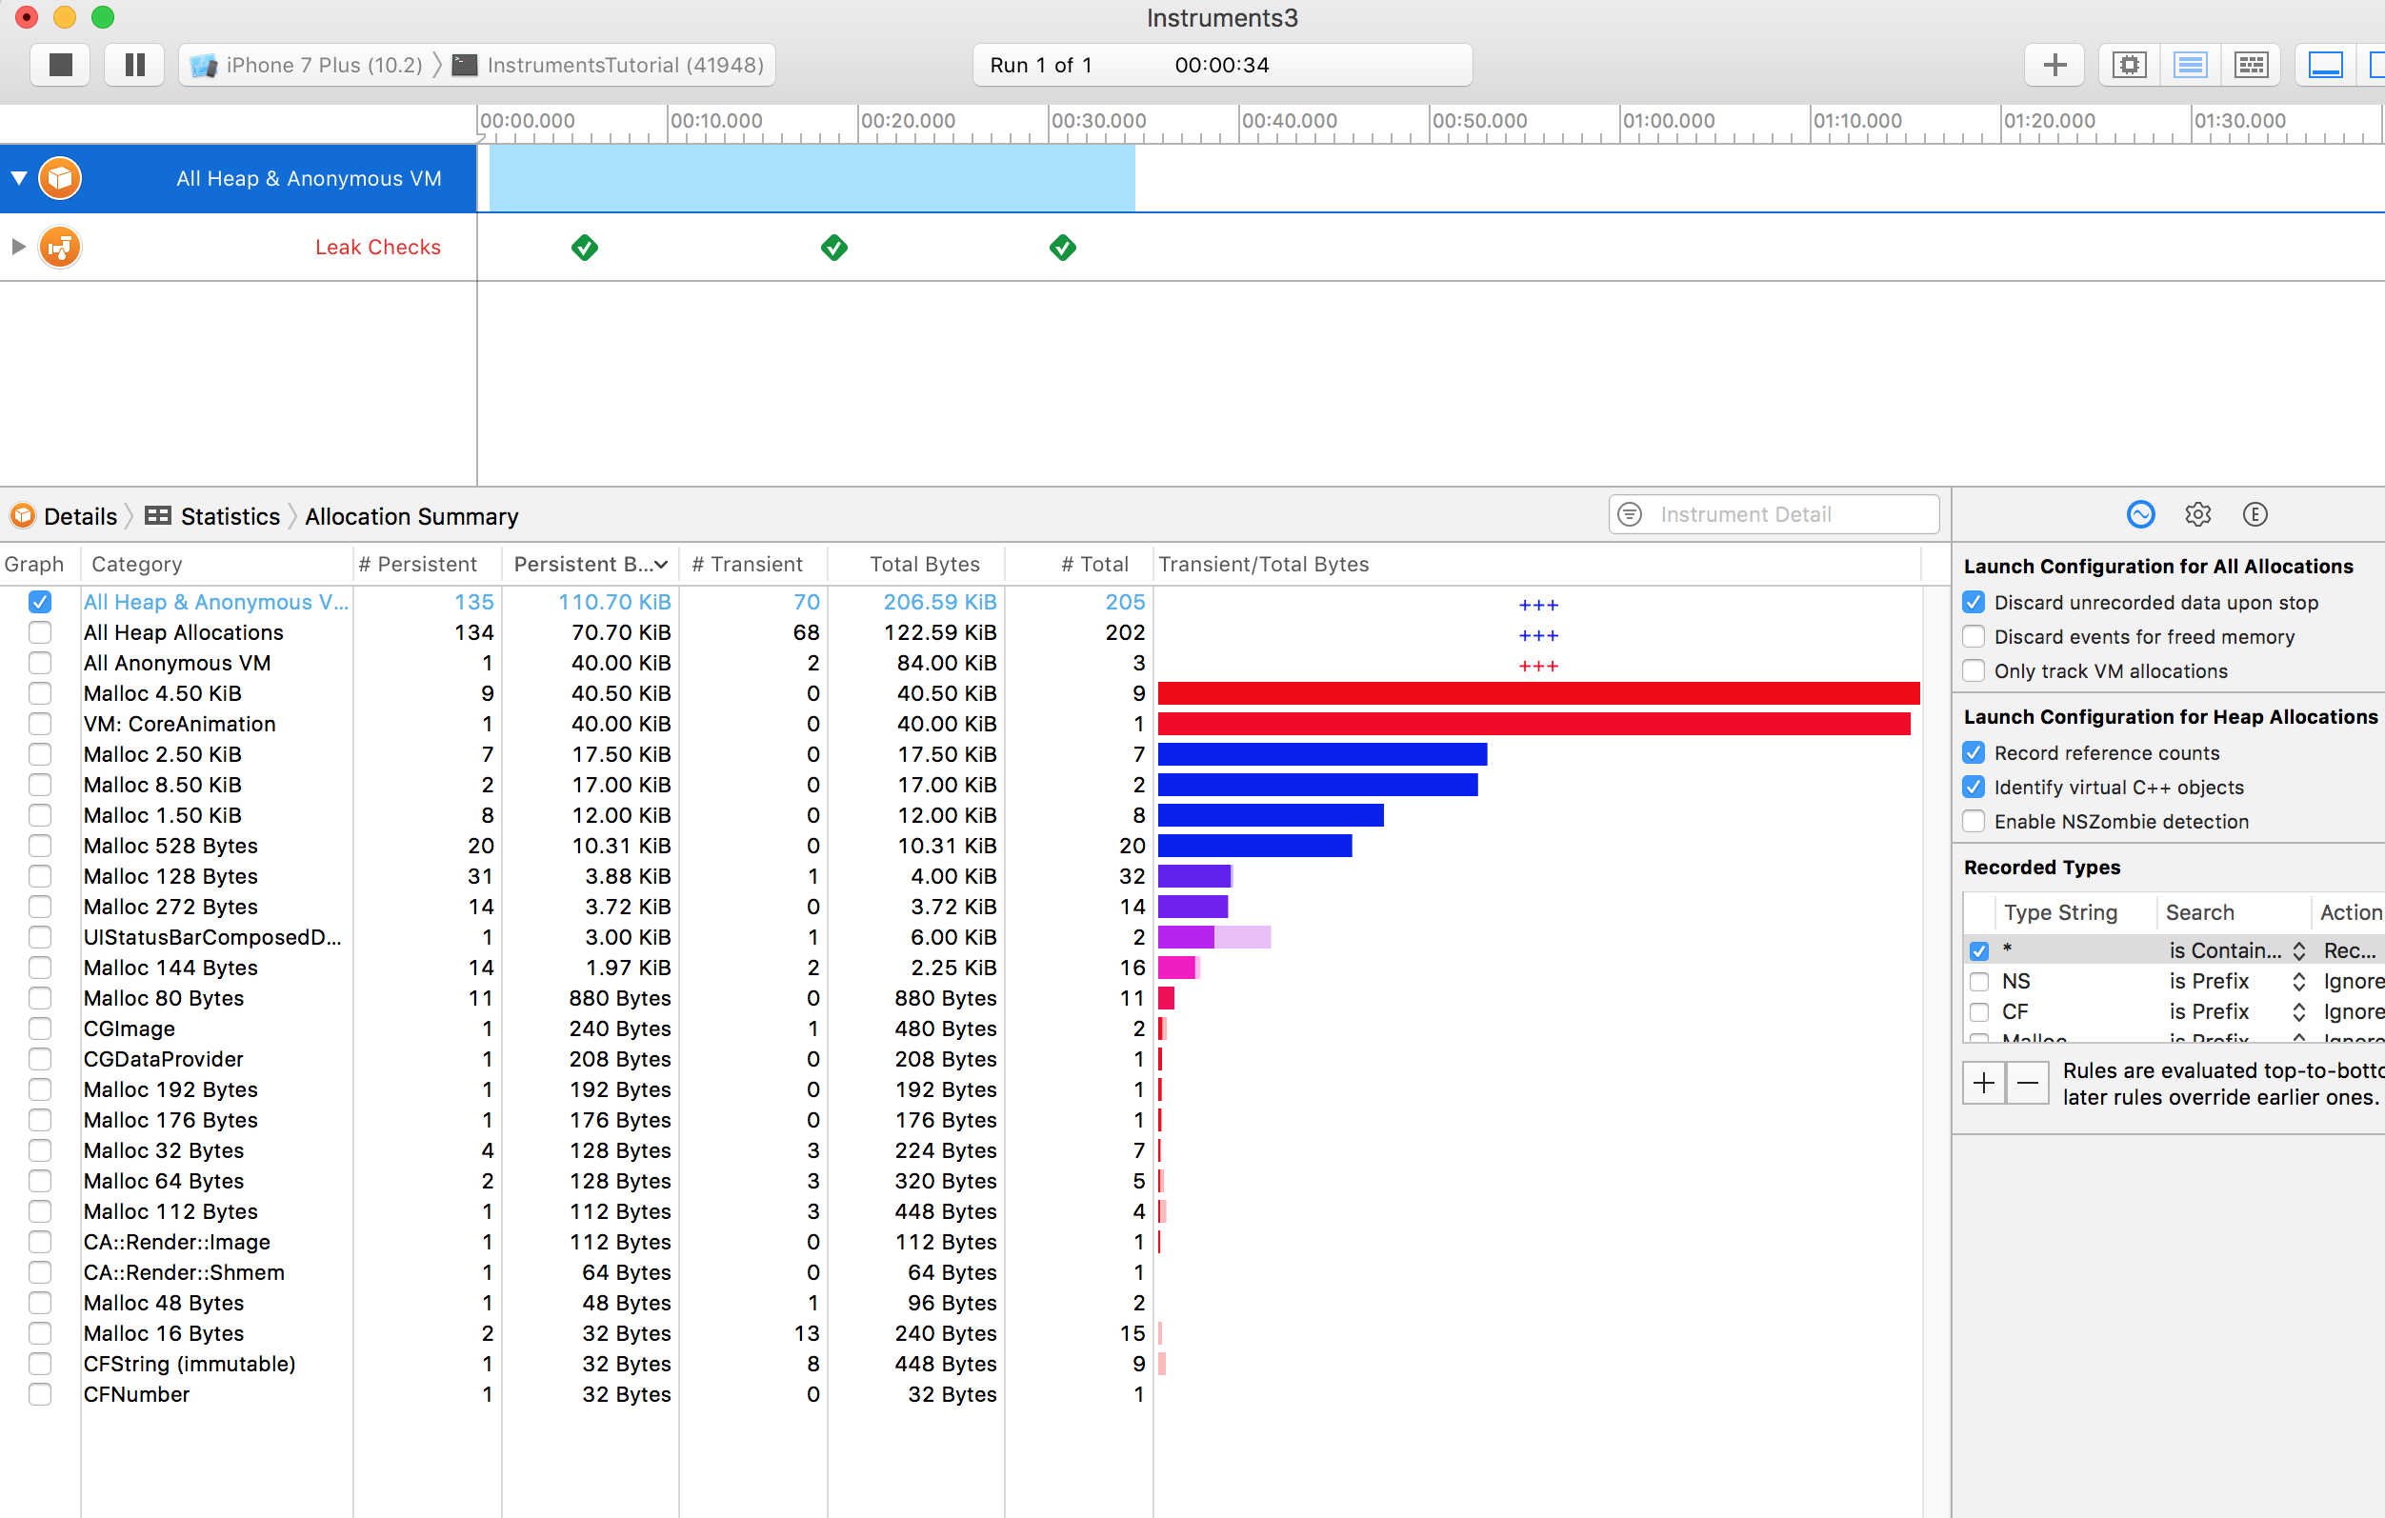
Notes:
hese graphs are useful for to get a quick idea about how your app is performing. But you’re going to need a bit more power. Click the Profile in Instruments button and then Transfer to bring this session into Instruments. The Allocations instrument will start up automatically.
This time you’ll notice two tracks. One is called Allocations, and one is called Leaks. The Allocations track will be discussed in detail later on; the Leaks track is generally more useful in Objective-C, and won’t be covered in this tutorial.

Slide 25
Memory Leaks
True Memory Leaks
Unbounded Memory Leak
Notes:
True memory leaks are where an object is no longer referenced by anything but still allocated – that means the memory can never be re-used. Even with Swift and ARC helping manage memory, the most common kind of memory leak is a retain cycle or strong reference cycle. This is when two objects hold strong references to one another, so that each object keeps the other one from being deallocated. This means that their memory is never released!
Unbounded memory growth is where memory continues to be allocated and is never given a chance to be deallocated. If this continues forever, then at some point the system’s memory will be filled and you’ll have a big memory problem on your hands. In iOS this means that the app will be killed by the system.

Slide 26
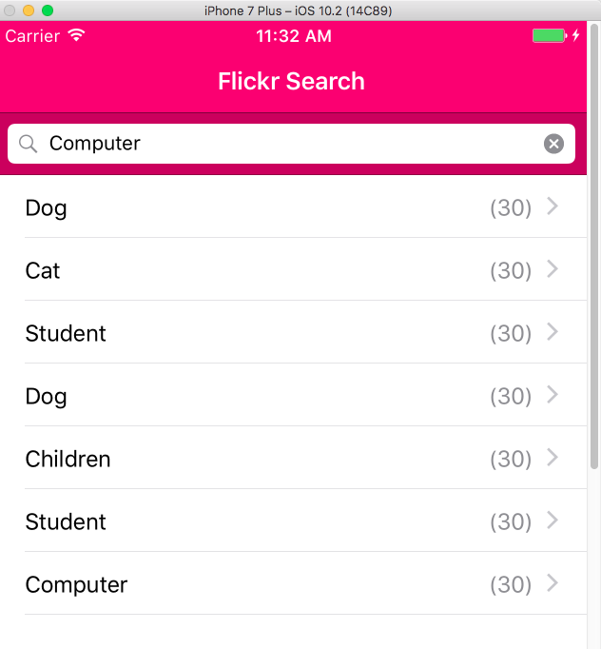
Notes:
With the Allocations instrument running on the app, make five different searches in the app but do not drill down into the results yet. Make sure the searches have some results! Now let the app settle a bit by waiting a few seconds.
You should have noticed that the graph in the Allocations track has been rising. This is telling you that memory is being allocated. It’s this feature that will guide you to finding unbounded memory growth.
What you’re going to perform is a “generation analysis”. To do this, press the button called Mark Generation. You’ll find the button at the top of the Display Settings inspector:

Slide 27
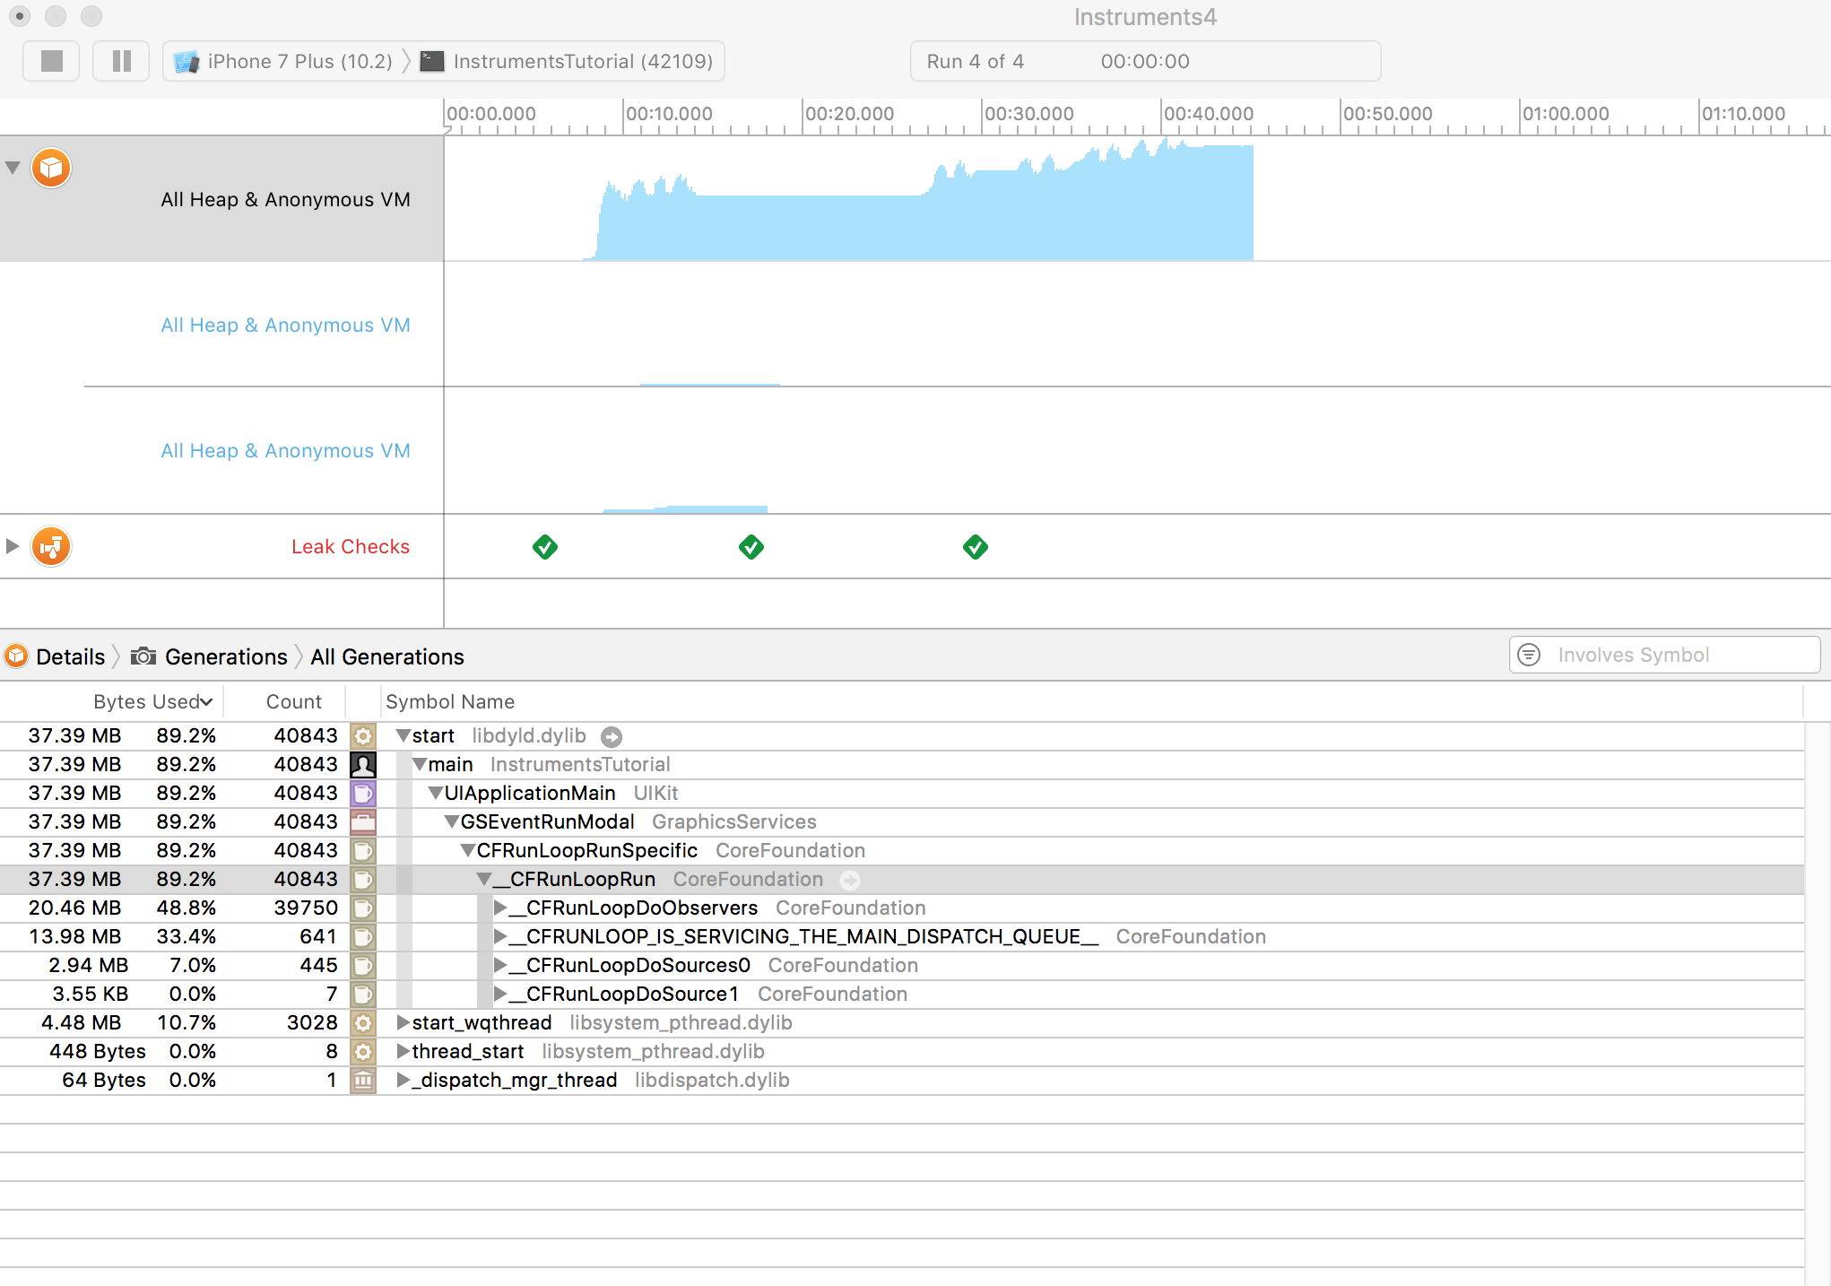
Notes:
With the Allocations instrument running on the app, make five different searches in the app but do not drill down into the results yet. Make sure the searches have some results! Now let the app settle a bit by waiting a few seconds.
You should have noticed that the graph in the Allocations track has been rising. This is telling you that memory is being allocated. It’s this feature that will guide you to finding unbounded memory growth.
What you’re going to perform is a “generation analysis”. To do this, press the button called Mark Generation. You’ll find the button at the top of the Display Settings inspector:

Slide 28
Notes:
Simulate a memory warning by selecting Instrument\Simulate Memory Warning in Instruments’ menu bar, or Hardware\Simulate Memory Warning from the simulator’s menu bar. You’ll notice that memory usage dips a little, or perhaps not at all. Certainly not back to where it should be. So there’s still unbounded memory growth happening somewhere.

Slide 29
Notes:
Look at the Growth column and you’ll see that there is definitely growth occurring somewhere. Open up one of the generations and you’ll see this:

Slide 30
Notes:
Unfortunately, Swift clutters up this view a lot more than Objective-C used to, filling it with internal data types that you don’t really need to know about. You can clean it up slightly by switching the Allocation Type to All Heap Allocations. Also, click the Growth header to sort by size.
Right near the top is ImageIO_jpeg_Data, and that’s certainly something that is dealt with in your app. Click on the arrow on the left of ImageIO_jpeg_Data to display the full list. Select one and then select the Extended Detail inspector (or press ⌘+3):

Slide 31
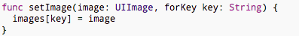
Notes:
This adds an image to a dictionary which is keyed on the photo ID of the Flickr photo. But if you look through the code, you’ll notice that the image is never cleared from that dictionary!
That’s where your unbounded memory growth is coming from: everything is working as it should, but the app never removes things from the cache — it only ever adds them!

Slide 32
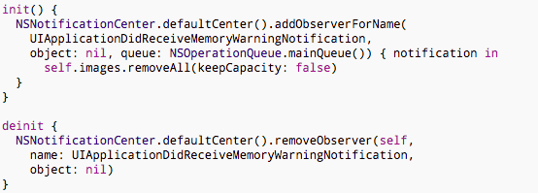
Notes:
To fix the problem, all you need to do is have ImageCache listen to the memory warning notification that UIApplication fires. When ImageCache receives this, it must be a good citizen and clear its cache.
To make ImageCache listen to the notification, add the following initializer and de-initializer to the class:
This registers an observer for UIApplicationDidReceiveMemoryWarningNotification to execute the closure above which clears images.
All that the code needs to do is remove all objects in the cache. This will ensure that nothing is holding onto the images any more and they will be deallocated.
To test this fix, fire up Instruments again (from Xcode with ⌘I) and repeat the steps you followed previously. Don’t forget to simulate a memory warning at the end!

Slide 33
Notes:
You’ll notice the memory usage dropped after the memory warning. There’s still some memory growth overall, but nowhere near as much as before.
The reason there’s still some growth is really due to the system libraries, and there’s not much you can do about those. It appears that the system libraries are not freeing all of their memory, which may be by design or may be a bug. All you can do in your app is free up as much memory as possible, and you’ve already done that! :]

Slide 34
Strong Reference Cycles
Notes:
Choose Allocations again

Slide 35
Strong Reference Cycles
Notes:
To help narrow down only the objects of interest, enter “Instruments” as a filter in the field above the Allocations Summary list. This will show only objects that feature the word “Instruments” in their type name. Because the sample app is named “InstrumentsTutorial”, the Allocations list will now only show types that are defined as part of this project. That makes things a bit easier!
The two columns worth noting in Instruments are # Persistent and # Transient. The Persistent column keeps a count of the number of objects of each type that currently exist in memory. The Transient column shows the number of objects that have existed but have since been deallocated. Persistent objects are using up memory, transient objects have had their memory released.

Slide 36
Strong Reference Cycles
Notes:
Back to the app! Perform a search and drill into the results. Notice that a bunch of extra objects are now showing up in Instruments: the FlickrPhotos that have been created when parsing the search results, the SearchResultsViewController, and the ImageCache amongst others. The ViewController instance is still persistent, because it’s needed by its navigation controller. That’s fine.
Now tap the back button in the app. The SearchResultsViewController has now been popped off the navigation stack, so it should be deallocated. But it’s still showing a # Persistent count of 1 in the Allocations summary! Why is it still there?
Try performing another two searches and tap the back button after each one. There are now 3 SearchResultsViewControllers?! The fact that these view controllers are hanging around in memory means that something is keeping a strong reference to them. Looks like you have a strong reference cycle!

Slide 37
Strong Reference Cycles
Notes:
Your main clue in this situation is that not only is the SearchResultsViewController persisting, but so are all the SearchResultsCollectionViewCells. It’s likely that the reference cycle is between these two classes.
Let’s delve into the code. Hover your mouse over InstrumentsTutorial.SearchResultsCollectionViewCell in the Category column, and click the small arrow to the right of it. This next view shows you all of the allocations of SearchResultsCollectionViewCells during the run of the app. There are quite a lot of them – one for each search result!
Change the Inspector to show the Extended Detail inspector, by clicking the third icon along at the top of the panel. This inspector shows the stack trace of the currently selected allocation. As with the earlier stack trace, the black parts are your code. Double-click the topmost black row (that begins “InstrumentsTutorial”) to see where the cell is allocated.

Slide 38
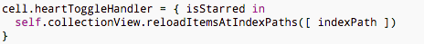
Strong Reference Cycles
Notes:
The cells are allocated at the top of collectionView(cellForRowAtIndexPath:). If you scan down a few lines, you’ll see this (with no help from Instruments to bring it to your attention, unfortunately!):
This is the closure that handles a tap on one of the heart buttons on the collection view cells. This is where the strong reference cycle lies, but it’s kind of hard to spot unless you’ve come across one before.
The closure cell refers to the SearchResultsViewController using self, which creates a strong reference. The closure captures self. Swift actually forces you to explicitly use the word self in closures (whereas you can usually drop it when referring to methods and properties of the current object). This helps you be more away of the fact you’re capturing it. The SearchResultsViewController also has a strong reference to the cells, via their collection view.

Slide 39
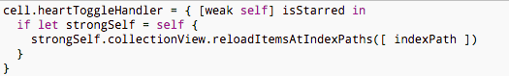
Strong Reference Cycles
Notes:
To break a strong reference cycle, you can define a capture list as part of the closure’s definition. A capture list can be used to declare instances that are captured by closures as being either weak or unowned:
Weak should be used when the captured reference might become nil in the future. If the object they refer to is deallocated, the reference becomes nil. As such, they are optional types.
Unowned references should be used when the closure and the object it refers to will always have the same lifetime as one another, and will be deallocated at the same time. An unowned reference can never become nil.
Declaring self as weak means that the SearchResultsViewController can be deallocated even though the collection view cells hold a reference to it, as they are now just weak references. And deallocating the SearchResultsViewController will deallocate its collection view, and in turn, the cells.

Slide 40
Agenda
Agile Swift
Notes:
Using Swift 3.0, and I didn't see a line called ImageIO_jpeg_Data when doing the unbounded growth section. Instead it is under < non-object >

